Slide 1
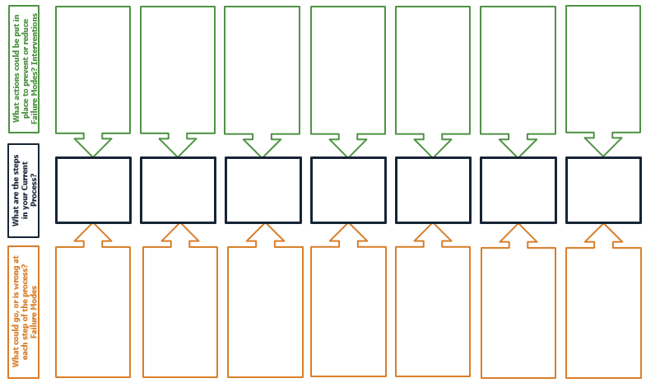
Purpose A Failure Modes Effects Analysis (FMEA) helps us look at each step of a process to identify what has gone wrong and what could prevent that from going wrong in the future.
Do
Act
Plan
Study
Failure Modes Effects Analysis (FMEA)
3
How to Facilitate It is essential to complete the FMEA as a team to increase the diversity of ideas and solutions, and to increase ownership of the success of the improved process. It may be useful to use sticky notes when capturing ideas from the team so they can be easily moved around (see below photo as an example).
1
2
Once all the components of the FMEA have been filled out, guide your team to rank each potential failure (Key Component 2 – see below) thinking about the severity of the failure, how frequently it happens, and how easy it is to detect. This will help identify which preventative actions should be prioritized.
Key Components
What are the steps in your current process?
Start by identifying the key steps of the process and fill out the
blue boxes.
Failure Modes: What could go, or is, wrong, at each step of the process?
For each step of the process, identify how the step could fail
(or has failed).
Interventions: What actions could be put in place to prevent or reduce failure modes?
Identify how each failure mode could be mitigated.

Slide 2
Failure Mode and Effect Analysis (FMEA)
Text
Text
Text
Text
Text
Text
Text
What actions could be put in place to prevent or reduce Failure Modes? Interventions
Text
Text
Text
Text
Text
Text
Text
What are the steps in your Current Process?
Text
Text
Text
Text
Text
Text
Text
What could go, or is wrong at each step of the process?
Failure Modes

Slide 3
EXAMPLE FMEA – Baking a Custom Cake
Ask customer first for call back number & email address
Get recipe from friend
Double check grocery list with recipe
Cross recipes off list when placed in basket
Double check basket before leaving store
Turn on the oven before starting to mix ingredients
Make sure icing/icing ingredients are on list
Get help carrying cake
Identify an easy recipe to make
Make a photocopy of recipe & take it to store
Read the directions all the way through before mixing
Write down customer address & phone number to bring along
Interventions
Go to larger store that has all the ingredients I will need
Buy extra icing
Double check recipe for oven temperature
Make cake using recipe on cake mix box
Take a cake decorating class
Double check directions
Set timer
Double check customer address
Current Process
Discuss customer cake order
Find a recipe
Make a list of ingredients
Buy ingredients from store
Mix ingredients
Bake cake
Decorate cake
Deliver cake to customer
Phone has bad reception
Can’t find a recipe for cake customer wants
Do not write down ingredients correctly
Store does not have an ingredient that I need
Don’t have what I need
Forget to turn oven on
Forget to buy icing/icing ingredients
Drop the cake on the way
Mix ingredients incorrectly
Forget to take the cake out
Don’t buy/make enough icing
Forgot customer address
I forget to buy an ingredient
Recipe is too hard
Failure Modes
Don’t give cake enough time to cook
Can’t decide which recipe to use
Poor decorating skills
Incorrectly wrote down customer address

